Slide 1

Introduction to Hybrid SQL Server Environments

Slide 2



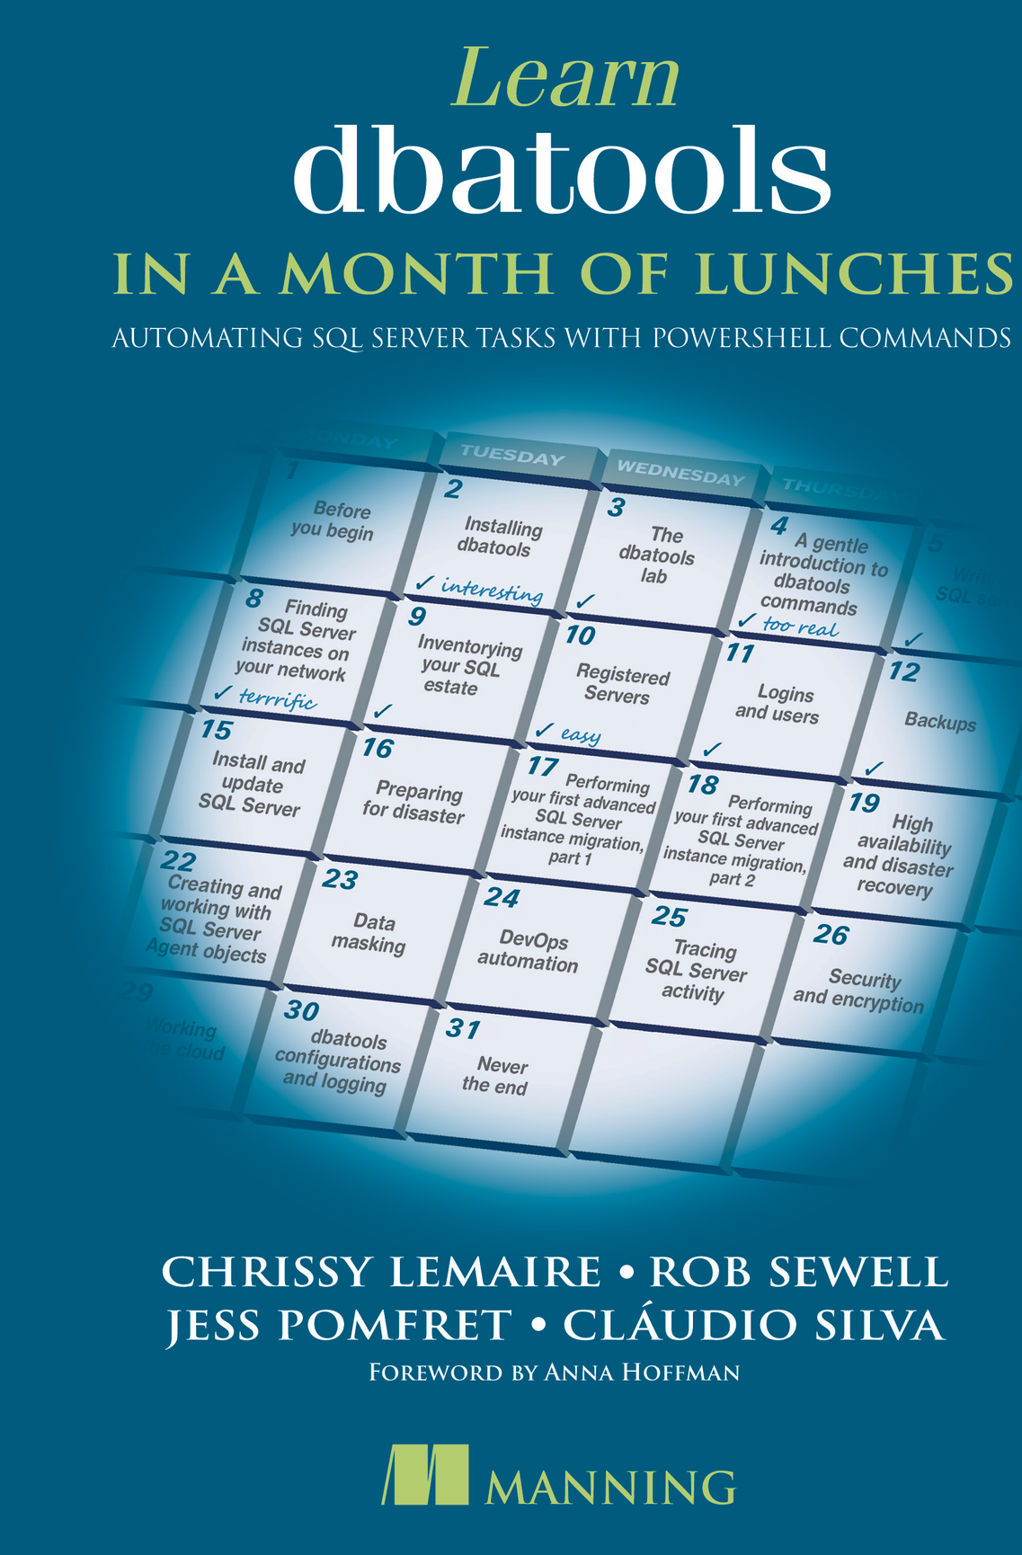


jpomfret7@gmail.com
Jess Pomfret
She/Her
I'm a data platform engineer with a passion for automation, proper football, and fitness. I enjoy contributing to open-source software and I'm a maintainer for dbatools.
DATA MASTERMINDS
Data Platform Engineer
DUAL MICROSOFT MVP
Cloud and Data Center Management
Data Platform
JESSPOMFRET.COM
Notes:
J

Slide 3




Rob Sewell
mrrobsewell@outlook.com
He/Him
I was a SQL Server DBA with a passion for Powershell, Azure, Automation, and SQL (PaaS geddit?) (And a sense of humour (and a habit for writing inside braces)). Now I just help other people with those (not the braces bit).
SEWELLS CONSULTING LTD
Beard Twizzler
DUAL MICROSOFT MVP
Data Platform
Cloud and Data Center Management
robsewell.com
Notes:
R

Slide 4
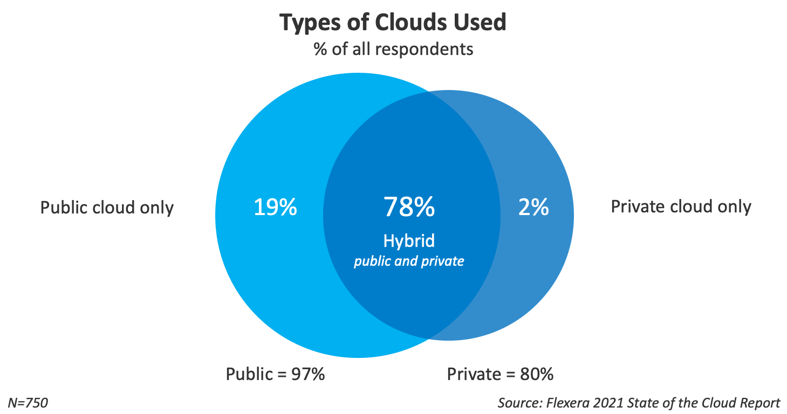

Slide 5

How do we get there?

Slide 6
Migration process
Month 1
Month 2 - 3
Month 4
Month 5 - n
Customer inputs
Business impact review
Selecting migration tool(s)
Technical planning meetings
Capacity planning and licensing review
Supplier inputs
Detailed specification
Migration implementation
Capacity review
Installation of monitoring tool
Automated data collection (3 months)
Customer outputs
Target architecture plan
Requirements specification document
Detailed specification document
Capacity review document
Monetized savings calculation
Capacity plan

Slide 7






Transition to Hybrid Environments
Milestone 1
Milestone 3
Milestone 5
Milestone 7
Assess current on-premises infrastructure and requirements
Migrate non-critical workloads to cloud
Migrate business-critical workloads
Train staff on managing hybrid environment
Milestone 2
Milestone 4
Milestone 6
Design hybrid architecture and select cloud services
Test hybrid environment with pilot users
Optimize data sync and access across environments

Slide 8

What about when you get there?

Slide 9
Managing Databases in Hybrid Setups
Data Synchronization
Query Performance
Security
Keeping data in sync between on-prem and cloud databases is challenging due to latency and bandwidth constraints.
Queries may perform slower in hybrid environments due to data movement between environments.
Securing data across different environments requires thorough access control and encryption.
Monitoring
Disaster Recovery
Skill Gap
Monitoring performance and usage across diverse systems requires consolidated dashboards.
Hybrid environments require complex disaster recovery with failover across environments.
DBAs need skills for managing diverse systems like SQL Server, Azure SQL, and Cosmos DB.
Notes:
WorkloadTools
Managing Also – Azure Arc and say that we wont be touching this

Slide 10




Role of DBAs in Hybrid Environments
Monitor performance
Security management
Automation skills
Cloud administration
DBAs must monitor database performance across on-premise and cloud.
DBAs are responsible for security policies, access control, and audits across environments.
DBAs need skills in automation tools like PowerShell to efficiently manage hybrid environments.
DBAs must learn cloud-specific administration like provisioning resources and scaling.
The role of DBAs is critical in hybrid environments to ensure performance, security, automation, and effective administration across on-premise and cloud databases.
Notes:
Whats your Job? – Do you know anymore ?
Confidentiality Integrity Availability
Networking – Packets not people

Slide 11
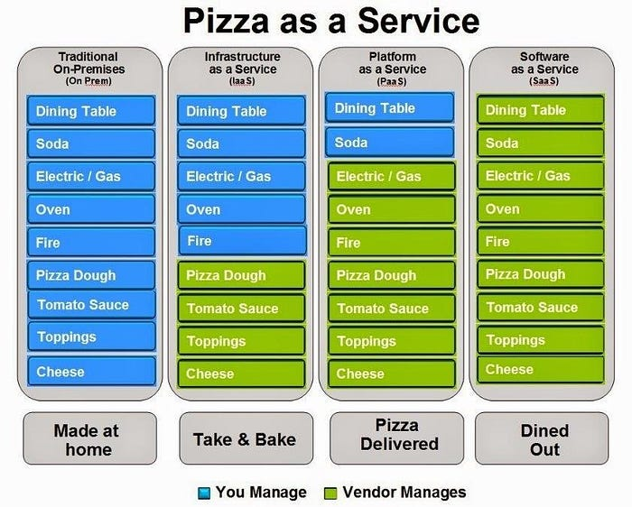

Slide 12
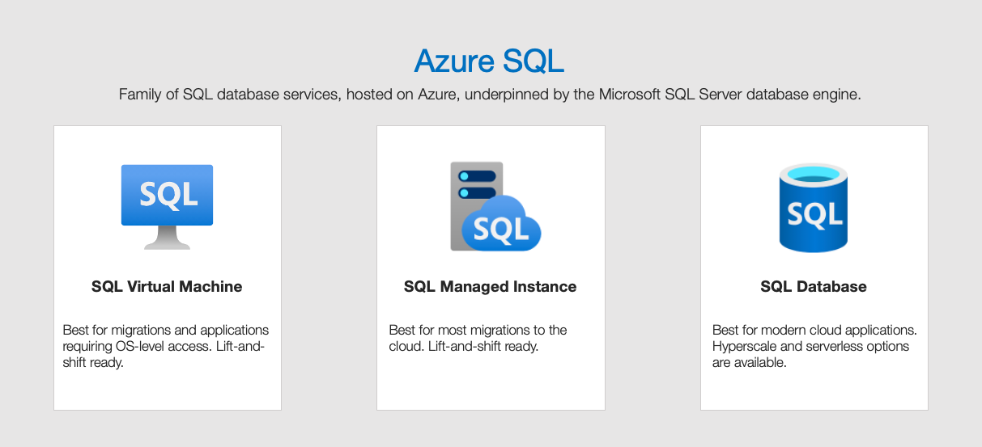
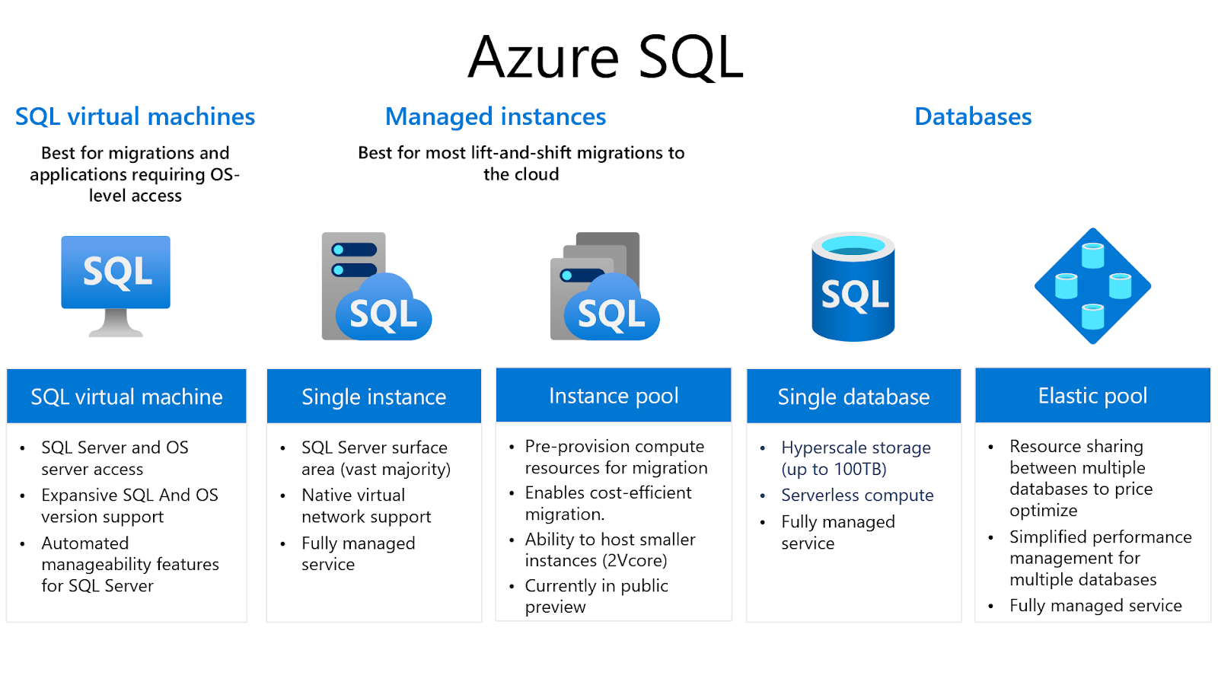
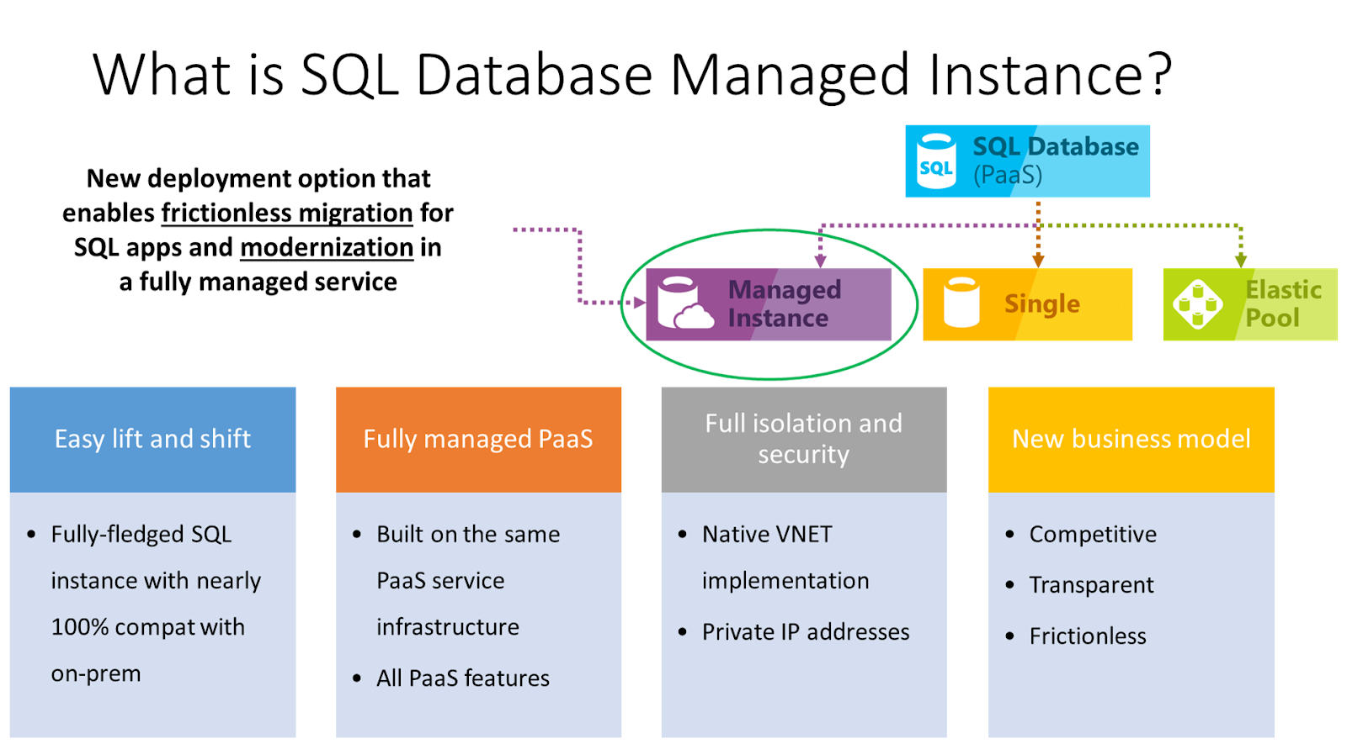

Slide 13




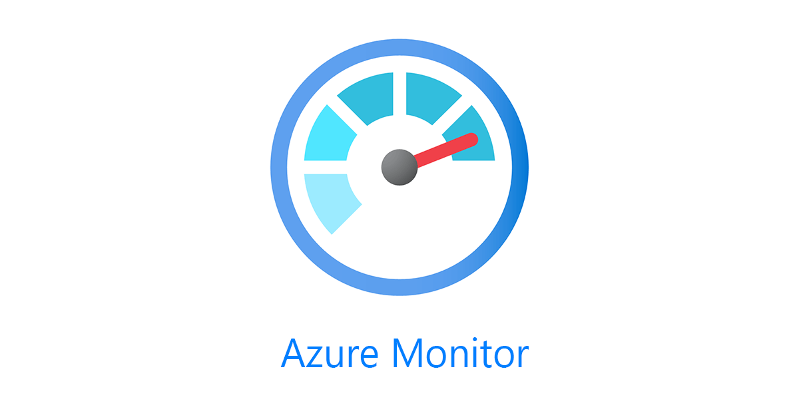

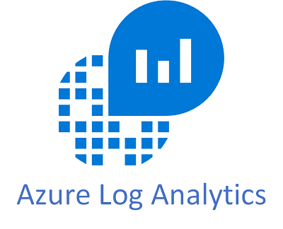
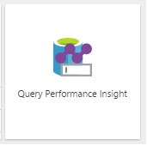

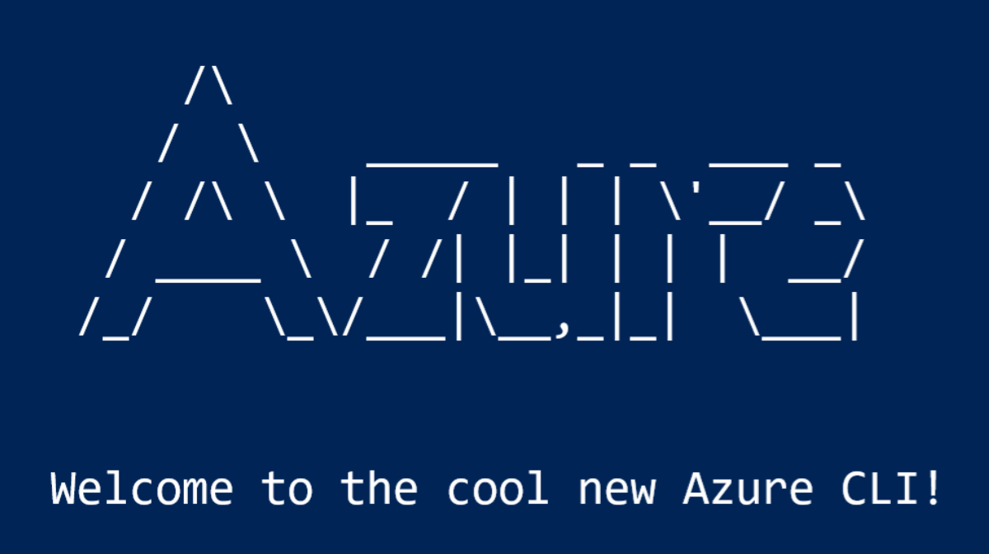


Tools for Managing Hybrid Environments
Notes:
ADS SSMS pwsh az cli portasl cl;oud shell Query Performance Insight in the portal query store log analytics, azure monitor sql monitor for Azure Cloud Defender 3rd party tooling

Slide 14


Slide 15

Come back at:
00:00
Notes:
Add a timer? Or agenda here

